Slide 1
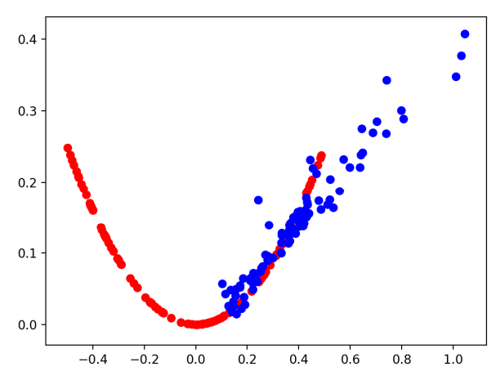
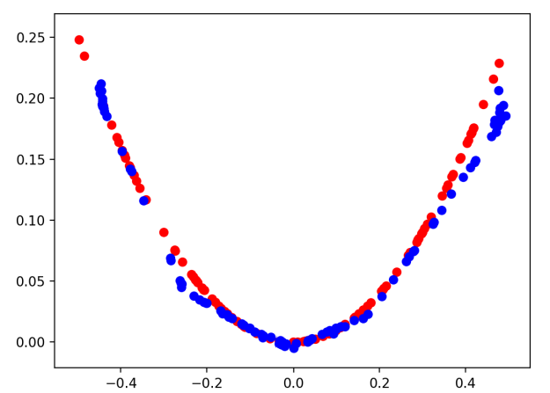
Developing a 1D GAN: From Start to Finish
Week 4: (02/18/2022)
Week Lead: Durant Fullington
GANS DIS Spring 2022
Notes:
Durant

Slide 2
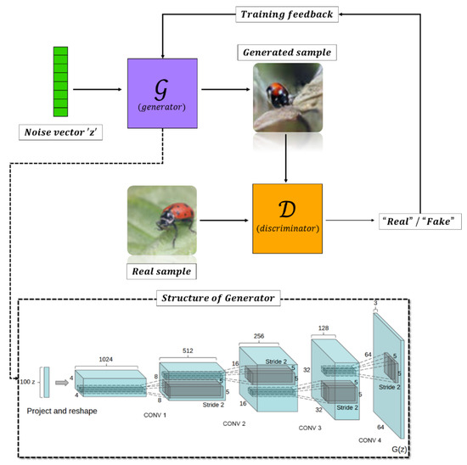
Review:
Latent Space
Generation Process for GANs
Notes:
Durant

Slide 3
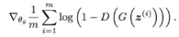
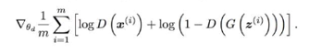
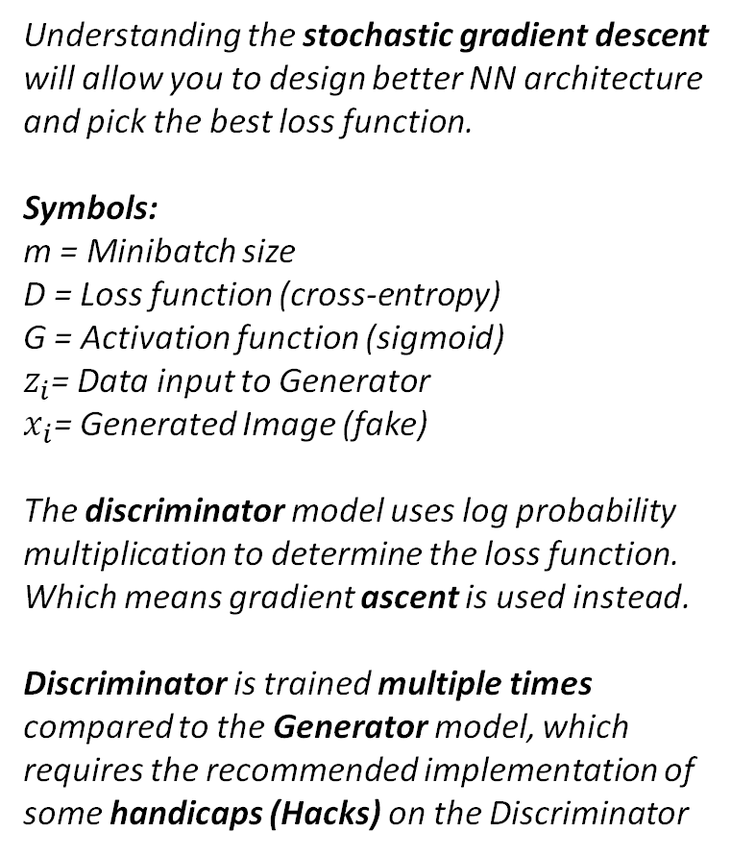
Review: GAN Loss Function and Training
Understanding the stochastic gradient descent will allow you to design better NN architecture and pick the best loss function.
Symbols:
m = Minibatch size
D = Loss function (cross-entropy)
G = Activation function (sigmoid)
$z_{i}$= Data input to Generator
$x_{i}$= Generated Image (fake)
The discriminator model uses log probability multiplication to determine the loss function. Which means gradient ascent is used instead.
Discriminator is trained multiple times compared to the Generator model, which requires the recommended implementation of some handicaps (Hacks) on the Discriminator
Generative Model:
Did the generative model successfully fool the discriminator model.
Discriminator Model:
Was the model fooled by the generative model (gradient/non-binary)
What the model learned from the real data
Notes:
Preston

Slide 4
Meeting Overview
The Overview of generating a simple GAN is divided into 5 Subsections + 1 complete example of training the GAN
Choosing a One-Dimensional Function
Defining and Training the Discriminator
Defining the Generator
Training the Generator
Evaluating the Model Performance
+
Full Application Example
Notes:
Durant

Slide 5
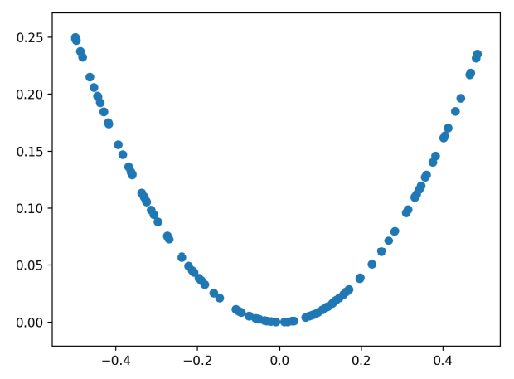
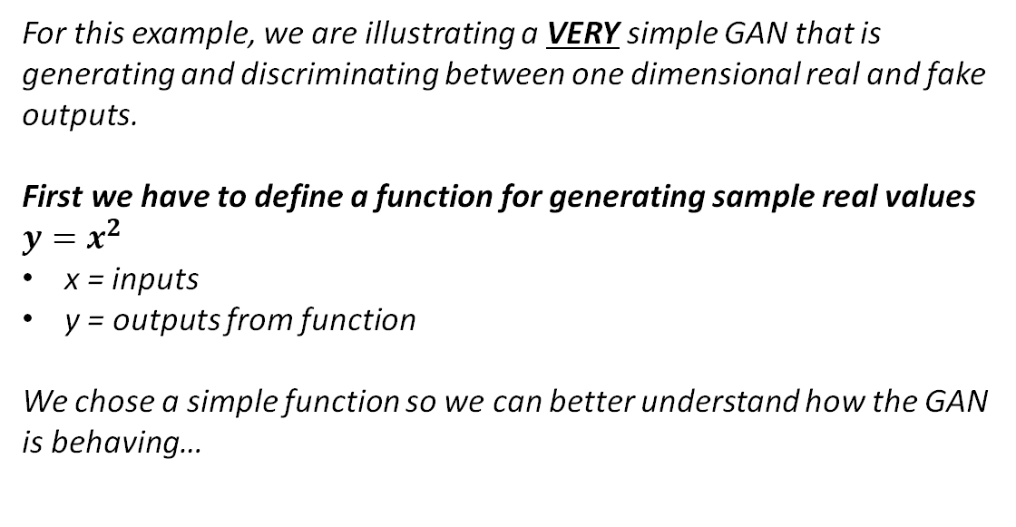
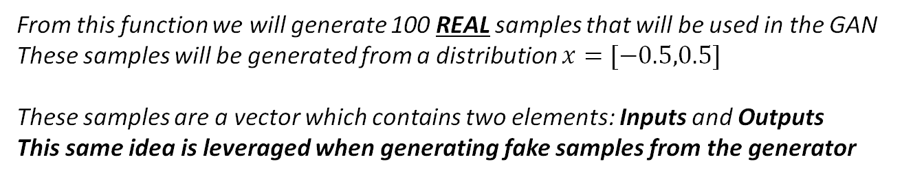
Selecting a One-Dimensional Function
For this example, we are illustrating a VERY simple GAN that is generating and discriminating between one dimensional real and fake outputs.
First we have to define a function for generating sample real values $y=x^{2}$
x = inputs
y = outputs from function
We chose a simple function so we can better understand how the GAN is behaving…
From this function we will generate 100 REAL samples that will be used in the GAN
These samples will be generated from a distribution $x=[−0.5,0.5]$
These samples are a vector which contains two elements: Inputs and Outputs
This same idea is leveraged when generating fake samples from the generator
Notes:
Durant

Slide 6
Defining the Discriminator
Next, we want to define the discriminator.
The discriminator is defined by two components:
Inputs
Outputs
The Inputs in this example is the vector containing the x and y values generated previously
The output is binary classification (Likelihood the sample is real “Realness”)
At this point, we define the Network Architecture and the parameters for the Discriminator
Number of Layers & Neurons
Activation Functions
Weight Initiation method
Number of output neurons
Loss function and Gradient Descent
1 Hidden Layer, 25 Neurons
1 Output Neuron
ReLu Activation Function for Hidden
Sigmoid Function for output
He Weight Initialization
Minimizing Cross-entropy Loss Function
Adam SGD
Notes:
Christian

Slide 7
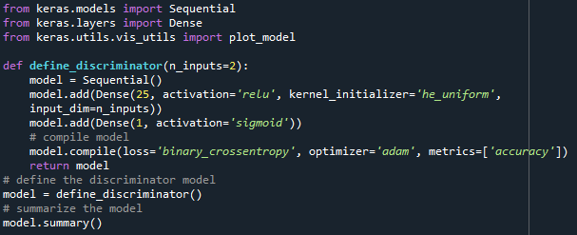
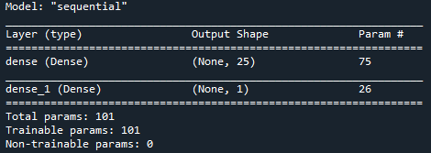
Defining the Discriminator Model
Notes:
Christian

Slide 8
Hidden Layer
1
2
X1
3
Input
2-Element Vector
Output
4
[0,1]
X2
5
6
…
25
Notes:
Christian

Slide 9
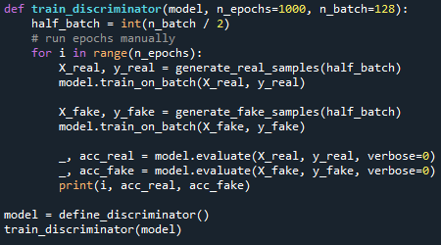
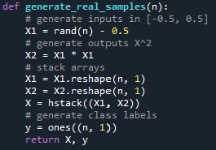
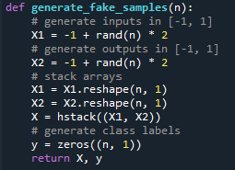
Training the Discriminator
After defining the Discriminator, we can train the discriminator without the need of the Generator (for the time being).
It is important to remember we are not focusing in on making an optimal discriminator, rather training the best generator we can.
This is accomplished by adjusting our x values to generate the “Fake” training samples, and then training the Discriminator on both the real and fake images, updating and model after each iteration
Notes:
Preston

Slide 10
Defining the Generator
Next, we want to define the Generator.
Like the Discriminator, the Generator is a standalone model that is defined separately…
The Generator is defined by two components:
Inputs
Outputs
The inputs for this example are random five-element vectors from the latent space
The outputs are two-element vectors representing synthetic values from the function
At this point, we define the Network Architecture and the parameters for the Generator
Number of Layers & Neurons
Activation Functions
Weight Initiation method
Number of output neurons
1 Hidden Layer, 15 Neurons
2 Output Neurons
ReLu Activation Function for Hidden
Linear Function for output*
He Weight Initialization
*A linear function is used for the output to help control the scale of the output vector
Notes:
Preston

Slide 11
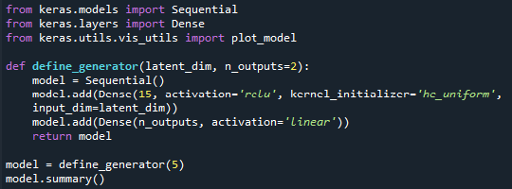
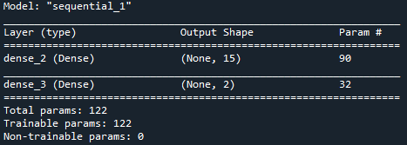
Defining the Generator Model
NOTES:
We do not compile the generator model like we compiled the discriminator
The Generator model, unlike the discriminator is not fit directly
We parameterize the input dimensions so we can adjust
Notes:
Preston

Slide 12
Hidden Layer
1
2
X1
3
Input 5-Element Vector (Latent Space)
Output
2-Element Vector
…
4
X5
5
6
…
15
Notes:
Preston

Slide 13
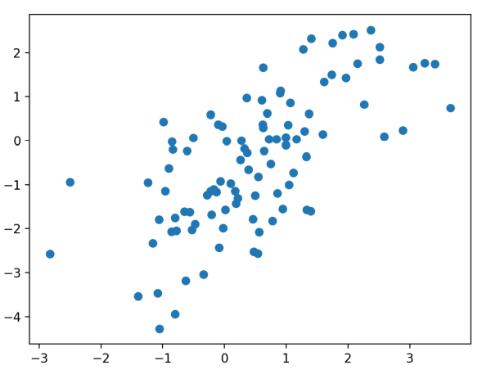
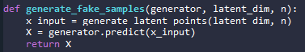
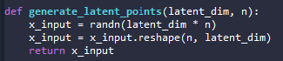
Defining the Generator
The first step is to understand how we are generating values and using the latent space as input to the Generator
We can generate the “latent points” that will act as input for the Generator
These generated points are fed into the generator and used to create the synthetic 2-element vector
Since we have not initiated training, the results are not useful, but illustrate the process
Notes:
Durant

Slide 14
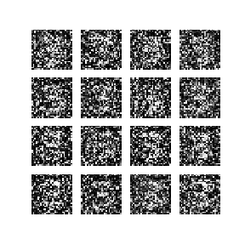
Training the Generator
Now that we understand how a Generator synthesizes the “fake” samples, lets explore how to train and improve the performance of the generator!
We know that the weights are updated based on the performance of the discriminator
If the discriminator is good at identifying Real/Fake images, the generator is updated more via a larger error gradient
If the discriminator is not performing well, the weights are updated less
The simplest and most effective method of combining these two models is by defining a parent model that encapsulates both the generator and discriminator
This is not an entirely new model; it is rather a combination of the two models we have just defined…
The discriminator only cares if images or real or fake, so generator is not needed to train discriminator
The generator only cares about the performance of the discriminator about the fake images
Notes:
Durant

Slide 15
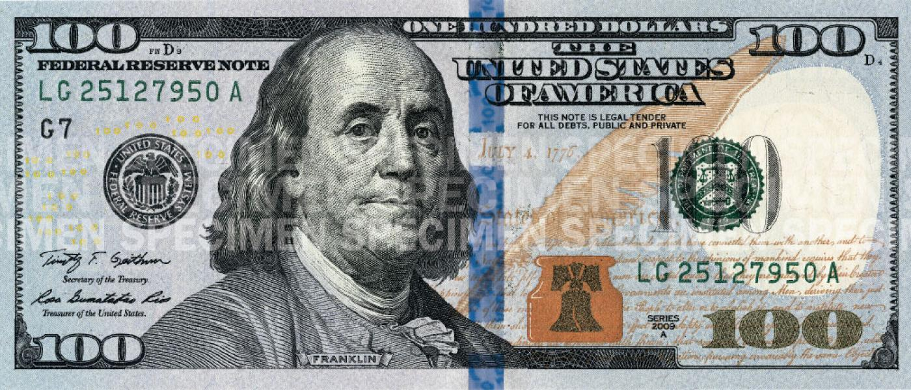
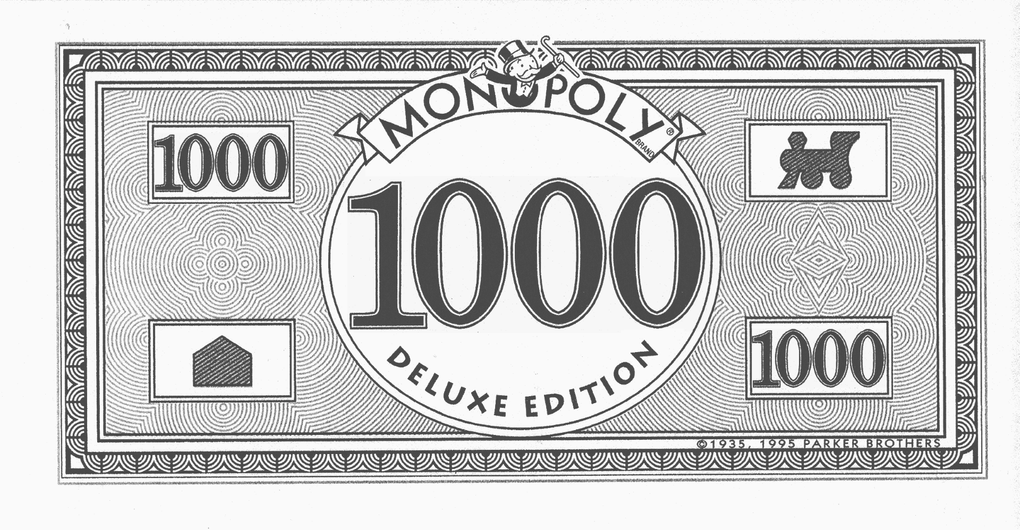
Training the Generator
When training the generator via this subsumed GAN model, there is one more important feature:
Mark the generated samples as real (class = 1).
The discriminator is evaluating the realness of an image. So, when this image is passed to the discriminator as a real image, it is probable that it will predict a low confidence (0.3 or 0.5) for the “realness” of a fake image (initially)
The backpropagation process used to update the model weights will see this as a large error and will update the model weights (i.e. only the weights in the generator) to correct for this error.
This in turn will make the generator better at generating plausible fake samples.
Realness = 0.96
Discriminator
Class = 1
Realness = 0.13
Generator
Class = 1
Large Error Gradient
Notes:
Durant

Slide 16
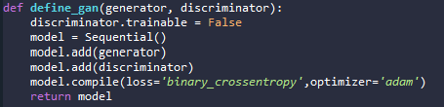
Training the Generator
We create a function hat we use to define the parent GAN function
This leverages the already defined generator and discriminator functions
It combines these two functions into a logical third model
The weights for the discriminator within the GAN are marked as trainable = False
This means the weights cannot be changed in the complied GAN model
The GAN model uses the same binary-cross entropy and adam SGD used in the discriminator model
Notes:
Christian

Slide 17
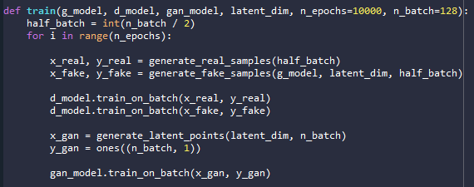
Training the Generator
Before this, we must first update the discriminator model with the real and fake images, and then update the generator via the parent model. So, we can define a function for training both
Notes:
Christian

Slide 18
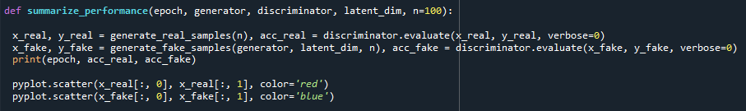
Evaluating Performance
Generally speaking, there are really very few objective ways of evaluating the performance of a GAN…
For GANS, generating synthetic images has both a subjective and objective importance. Images have to look real as well as fool the discriminator. Traditionally, the appearance of the generated image is a good evaluation of the performance of the model.
The Objective of the Generator is to cause the discriminator to only be able to achieve a classification score of about 50% accuracy when predicting real from fake examples
The author gauges the performance of the overall GAN, Generator v. discriminator, through evaluating how closely the generated points match the curve of the real points
Notes:
Preston

Slide 19
Evaluating Performance
After 2000 Epochs of Training
After 10,000 Epochs of Training
Notes:
Preston

Slide 20

That was a lot of code, lets look at the full python file!
Notes:
Everyone? – Basically was going to pull up spyder so they can see the code and we can show how it is all connected

Slide 21
Questions?

